Slide 1
MOBILE NETWORK ACCESS DEVICE FOR USE WITH THE DHS ADVANCED CONTAINER SECURITY SYSTEM
Sergio Enriquez

Slide 2
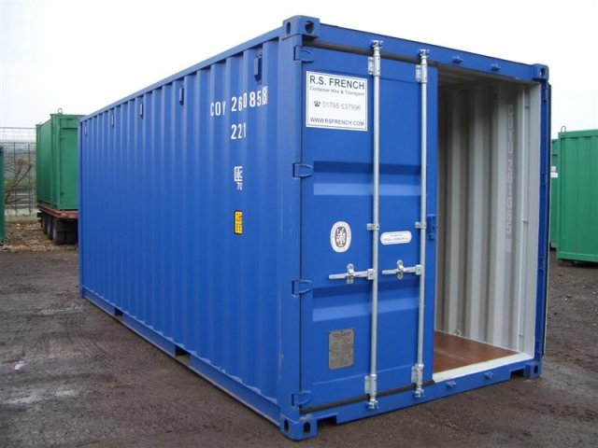

Slide 3
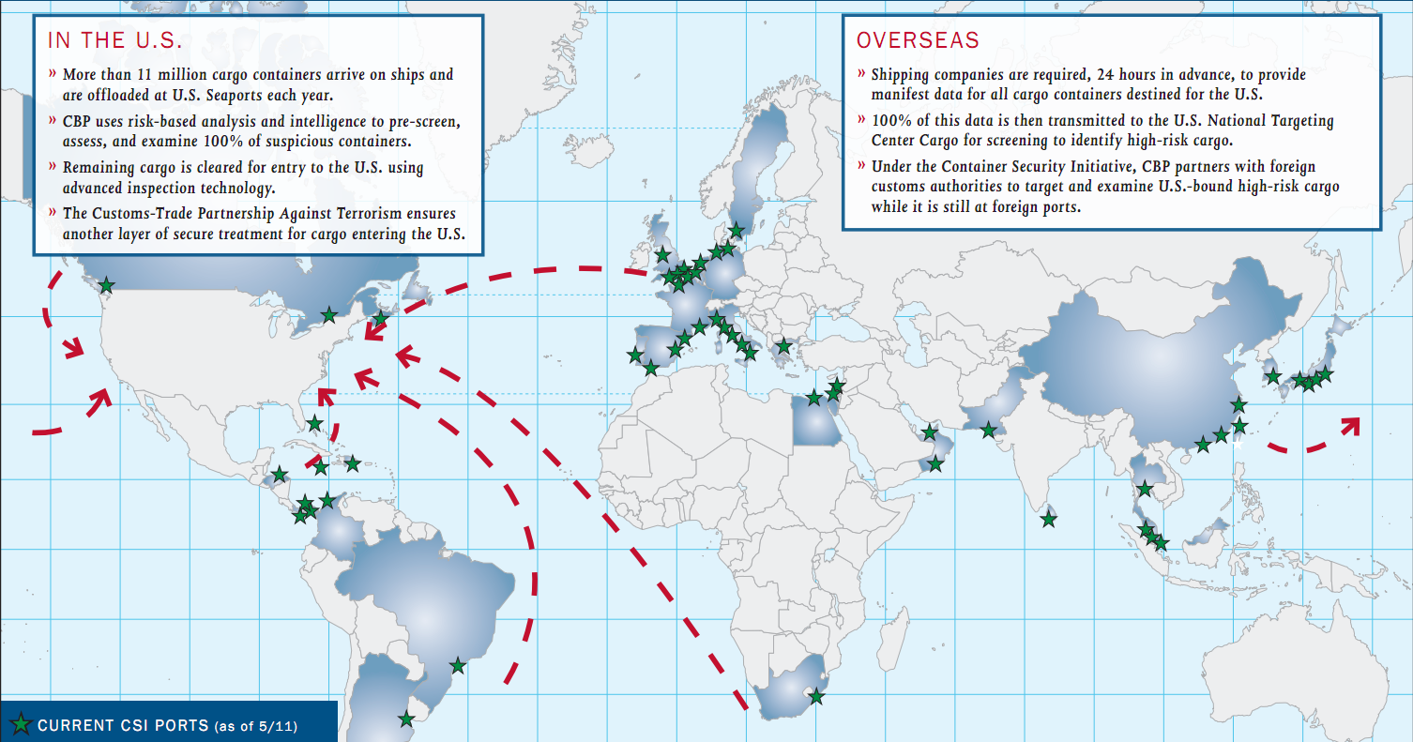

Slide 4
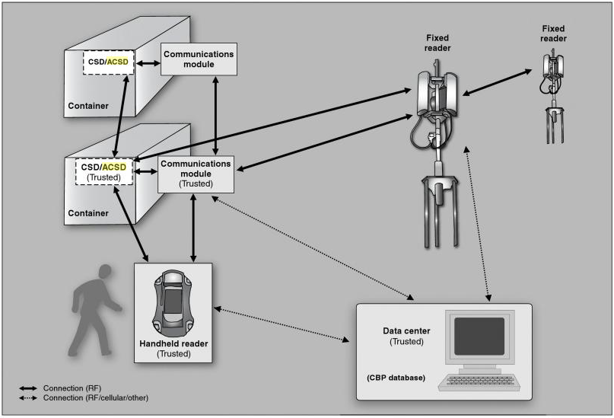
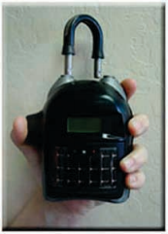
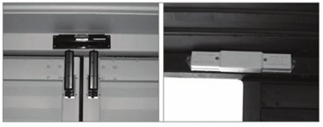

Slide 5
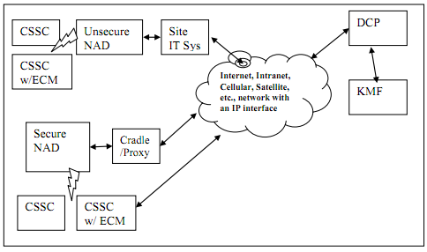

Slide 6
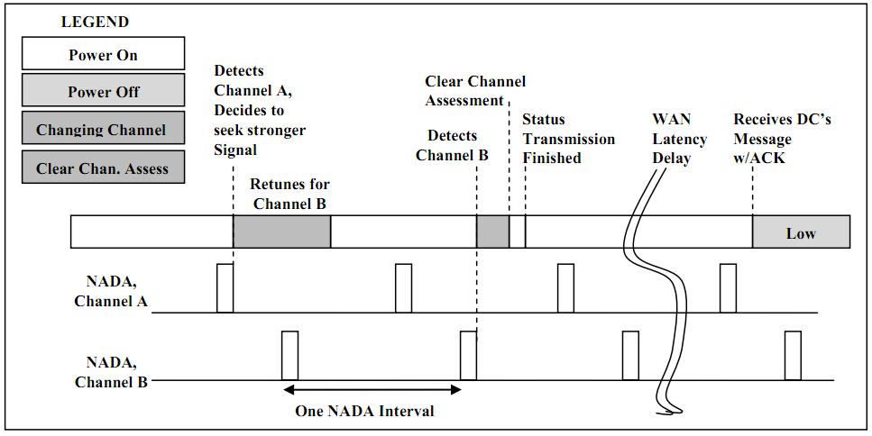

Slide 7
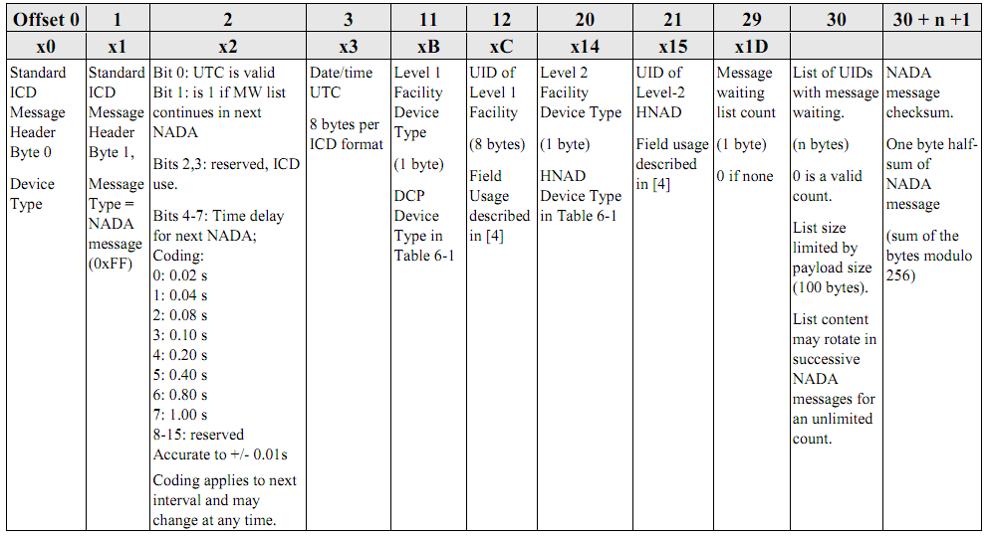

Slide 8
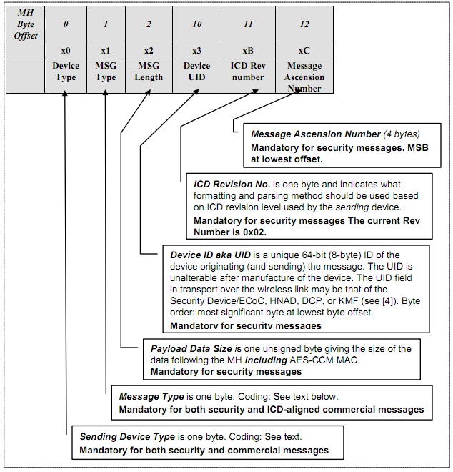
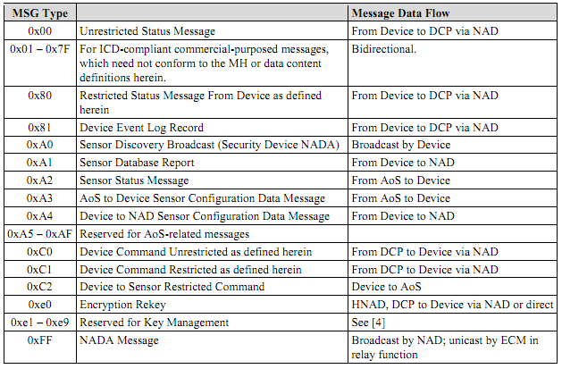

Slide 9
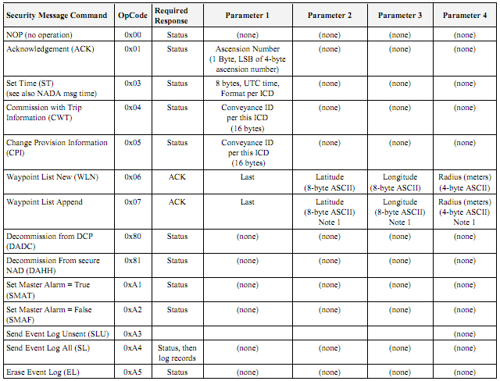
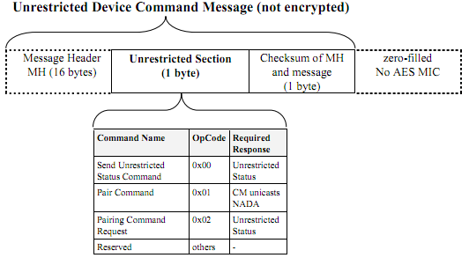

Slide 10
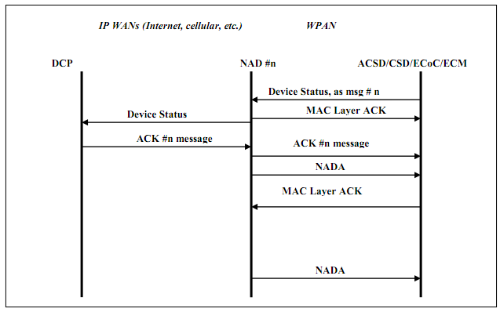

Slide 11
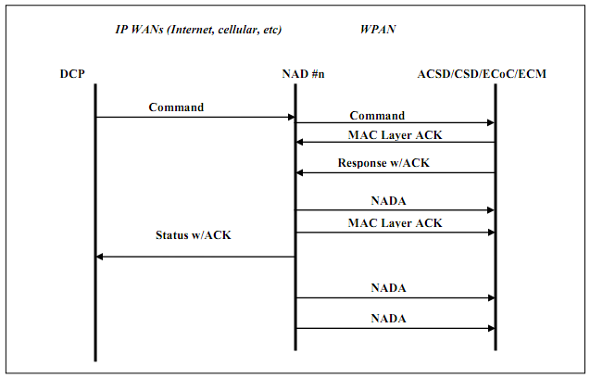

Slide 12
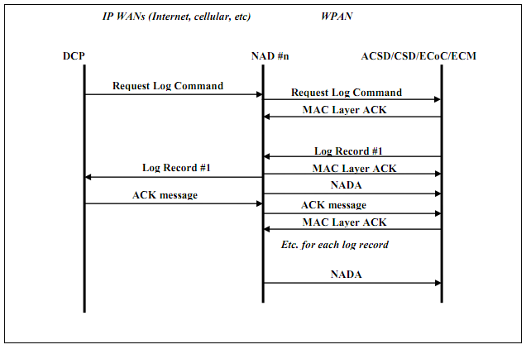

Slide 13
Field | Size (bytes) | Purpose
Revision | 1 | ICD revision used by source
Function Code | 1 | Identifies the payload type of this message
UID | 8 | Unique ID of the device transmitting this message
Payload | Varies | Content of this message
Code | Type
0 | Heartbeat
1 | Heartbeat Request
2 | ICD Content, DCP to NAD
3 | ICD Content, NAD to DCP
4 | DCP Configuration Change

Slide 14
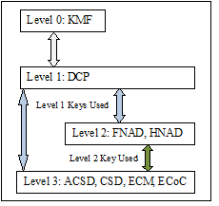

Slide 15
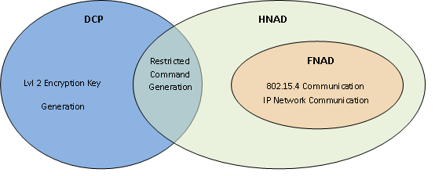

Slide 16
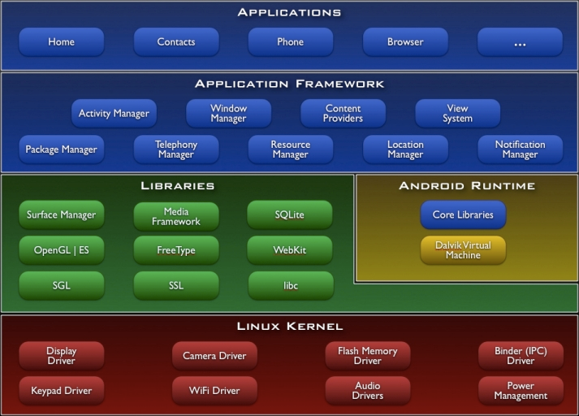

Slide 17
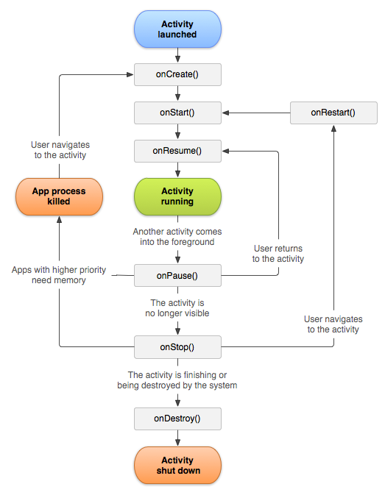

Slide 18
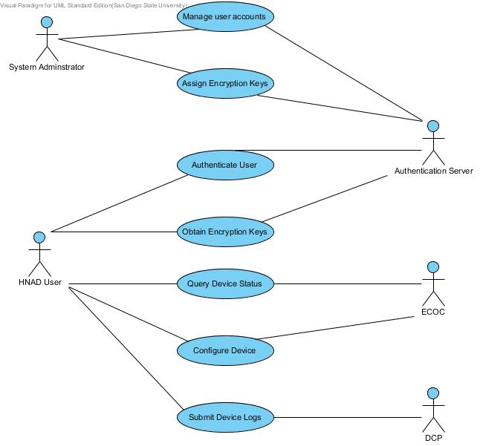

Slide 19
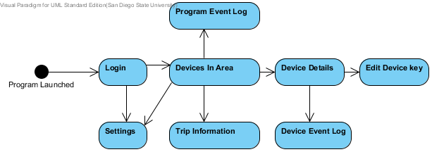

Slide 20
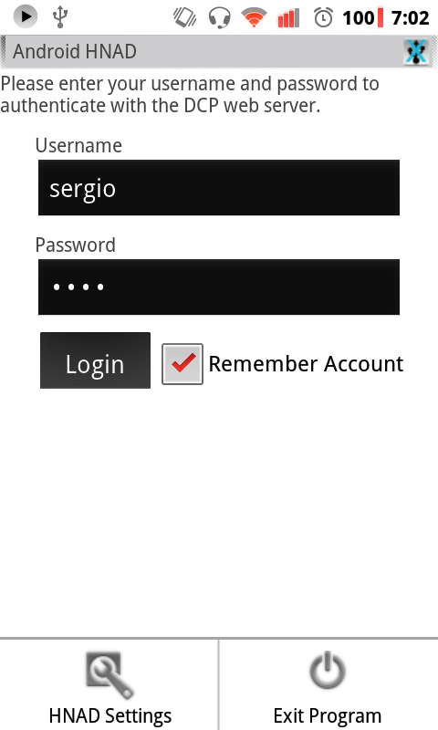

Slide 21
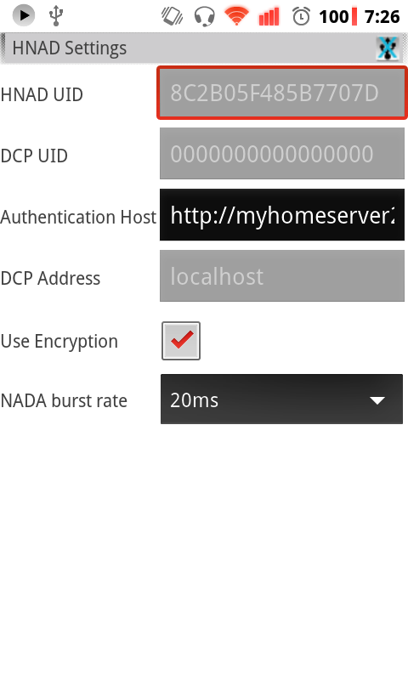

Slide 22
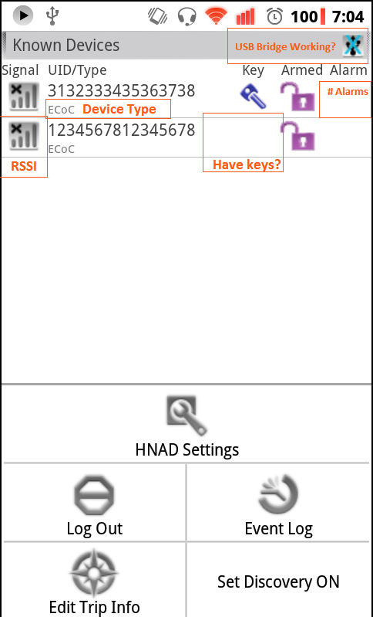

Slide 23
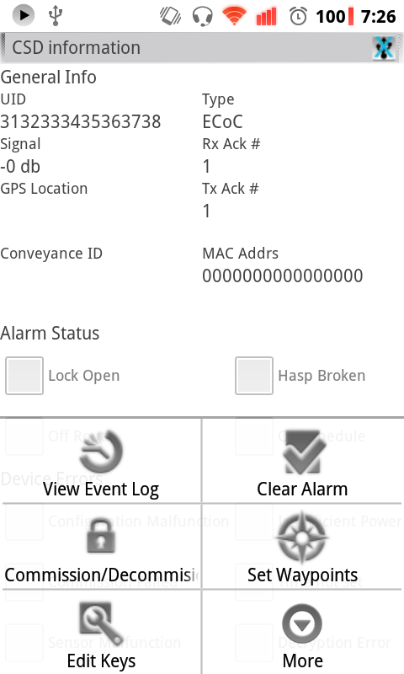

Slide 24
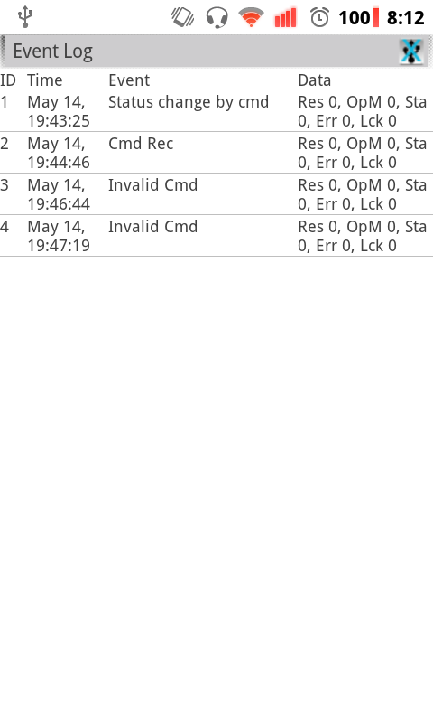

Slide 25
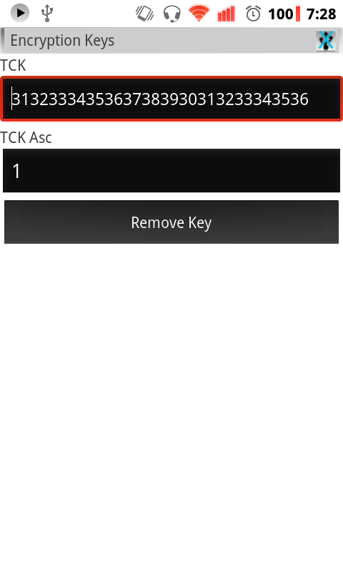

Slide 27
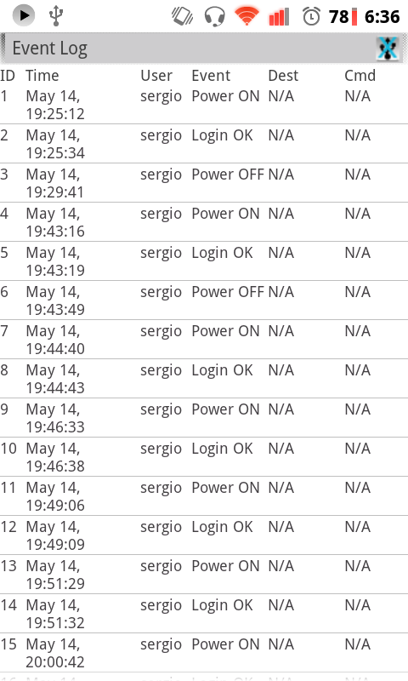

Slide 28
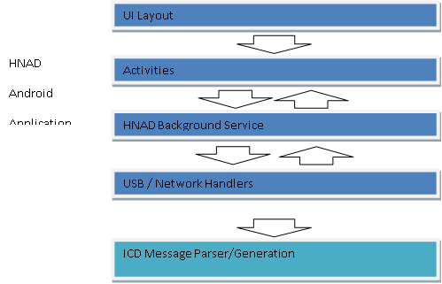

Slide 29
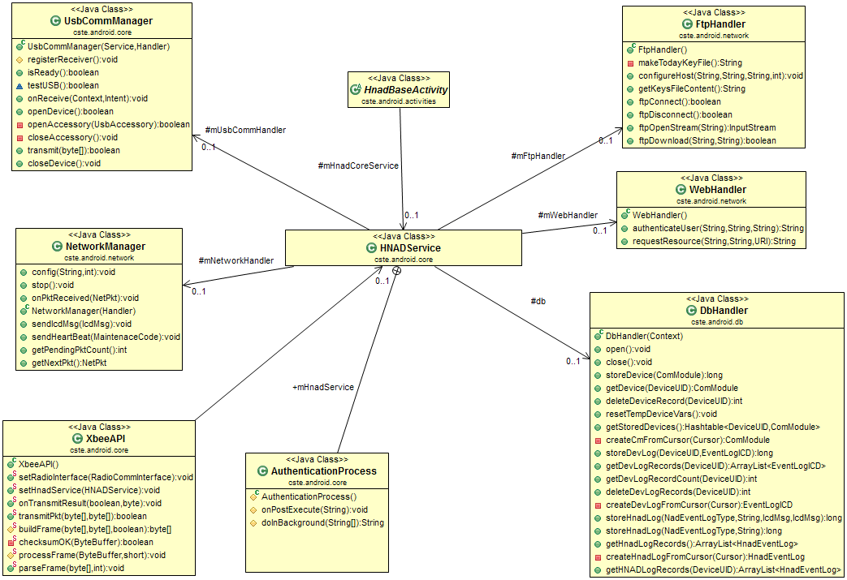

Slide 30
Broadcast type | Purpose | Payload
DEVICE_INFO_CHANGED | The status or some member variable of a device has changed due to the arrival of an external message | UID of affected device
DEVLIST_CHANGED | A new device is visible, or its record has been deleted from memory. | UID of new/removed device
LOGIN_RESULT | Result of an authentication attempt | Boolean
UPLOAD_DATA | Result of submitting data to the DCP over the internet | Boolean
USB_STATE_CHANGED | USB accessory has been disconnected/ connected | Boolean
TRANSMISSION_RESULT | Result of sending data to a device on the 802.15.4 wireless network | UID of destination, Boolean
ECM_EVENTLOG_CHANGE | A new device record was added | UID of affected device, Row ID
HNAD_EVENTLOG_CHANGE | A new HNAD record was added | Row ID

Slide 31
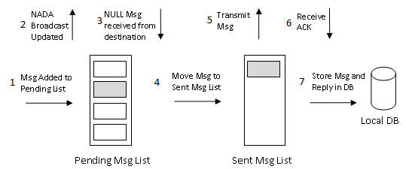

Slide 32
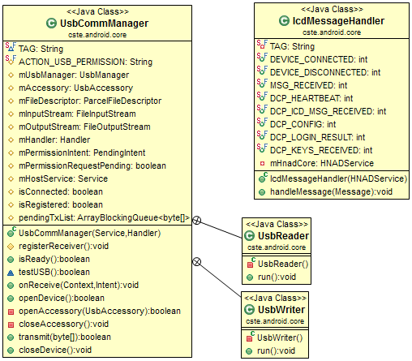

Slide 33
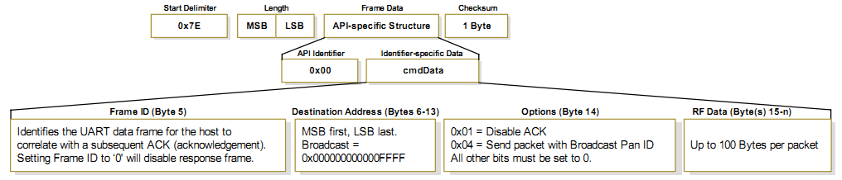
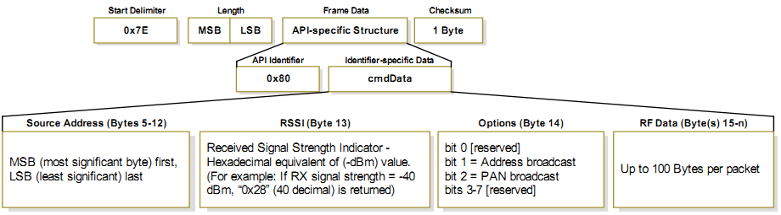

Slide 34
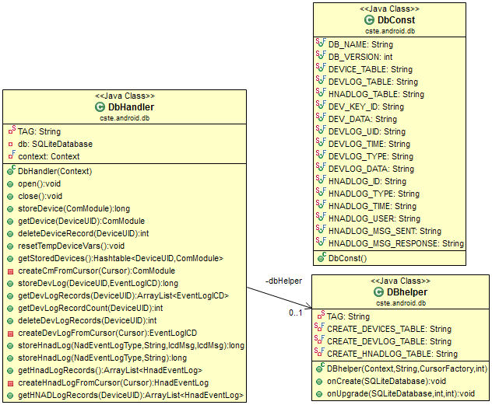

Slide 35
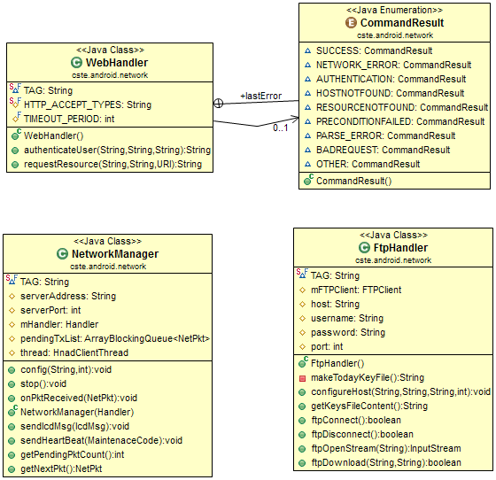

Slide 36
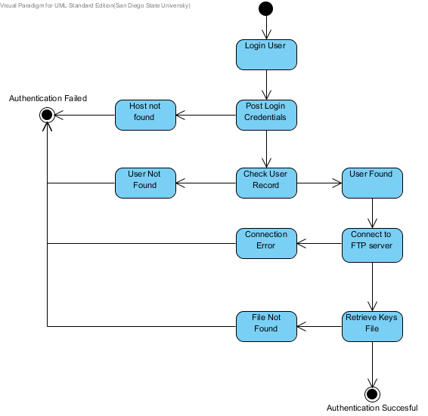

Slide 37
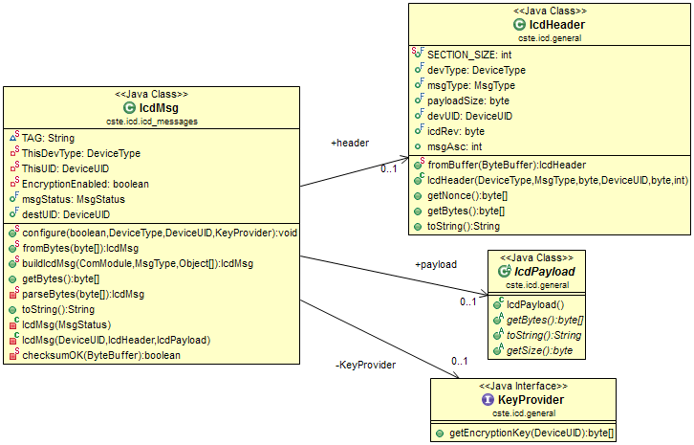

Slide 38
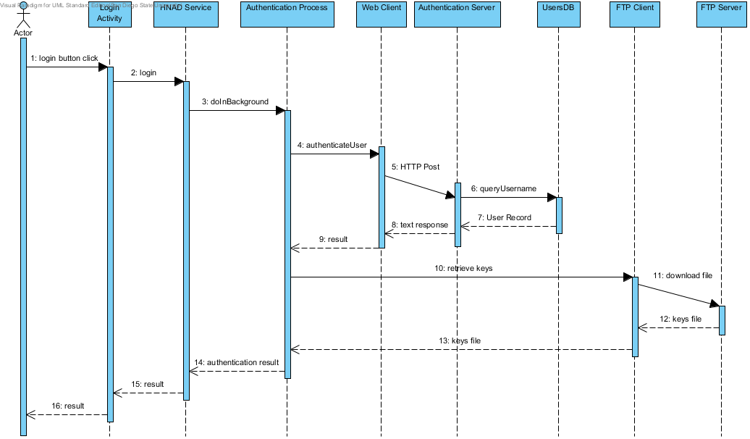

Slide 39
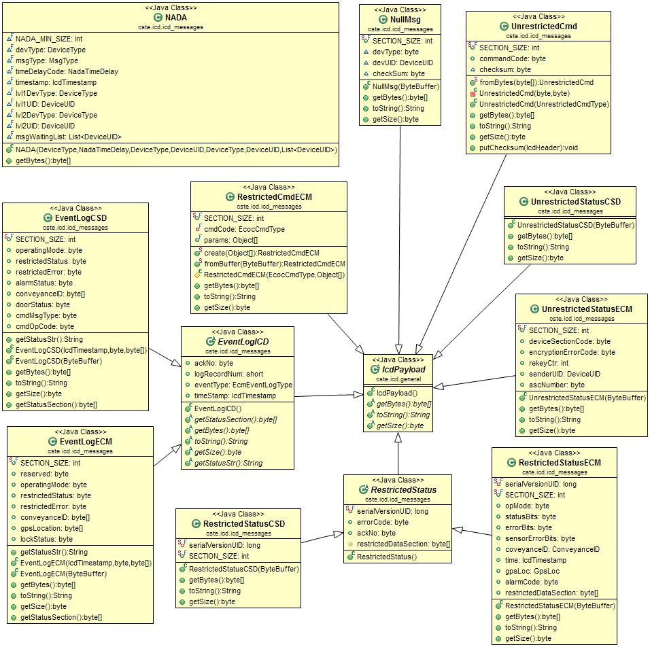

Slide 40
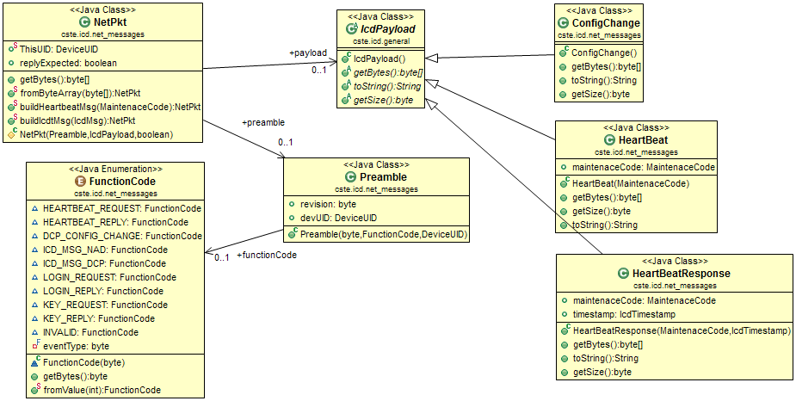

Slide 41
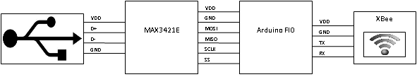

Slide 42
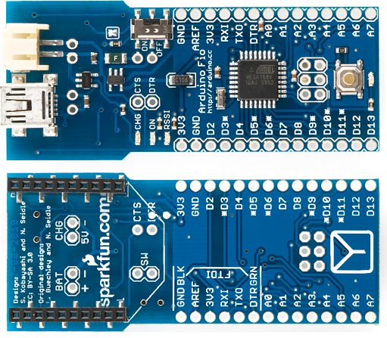
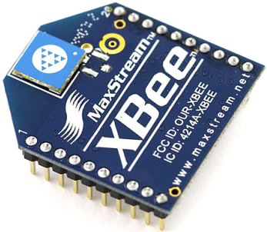
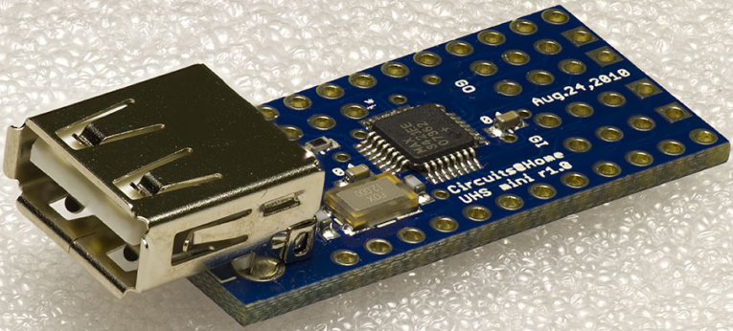

Slide 43




Slide 44
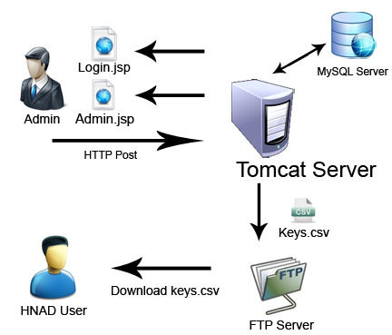
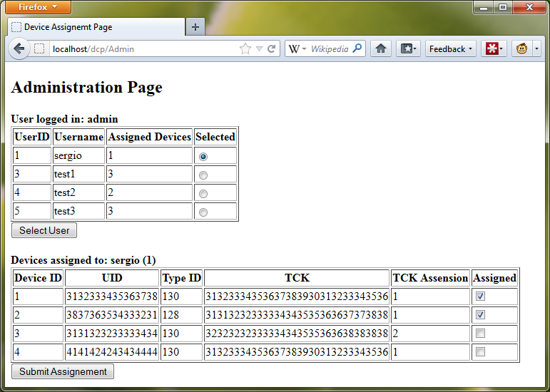

Slide 45


